Slide 1
Welcome To York Code Dojo
Yorkdevelopers.org
@yorkdevelopers
@yorkcodedojo

Slide 2
Agenda
Quick Introduction
Explain the problem
Work in pairs till 8.45pm
Opportunity to show off solutions
Pub about 9pm

Slide 3
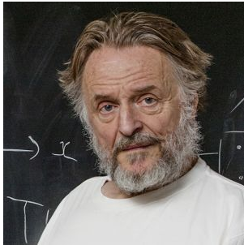
Conway’s Game Of Life
Notes:
John Horton Conway was born in England in 1937 and began his mathematics career at Cambridge University
Conway was interested in a problem presented in the 1940s by mathematician John von Neumann, who attempted to find a hypothetical machine that could build copies of itself and succeeded when he found a mathematical model for such a machine with very complicated rules on a rectangular grid.
He used to solve the problems using pen and paper rather than by computer

Slide 4




The Rules
Any live cell with fewer than two live neighbours dies, as if caused by under-population.
Any live cell with two or three live neighbours lives on to the next generation.
Any live cell with more than three live neighbours dies, as if by over-population.
Any dead cell with exactly three live neighbours becomes a live cell, as if by reproduction.
Notes:
For our model we have a grid of cells,
Each cell can be either alive or dead
To start with you make some of the cells alive
You then calculate the next generation using these four rules

Slide 5
Examples
Shapes
Programs
Notes:
Step though a couple of examples using the graphics UI
Show the simple dos version
Show microbit video

Slide 6
Ideas
Clean Code
Speed
Functional
Language
Notes:
Who has done the game of life before?
Separate UI from the logic so that you can unit test the logic
How fast can you iterate through the generations
Can you write your code using a functional approach? No if statements, no more than 4 lines of code per function
Code it in a language you haven’t used before

